Slide 1
Spiking neural network

Slide 2
Leaky Integrator Neurons

Slide 3
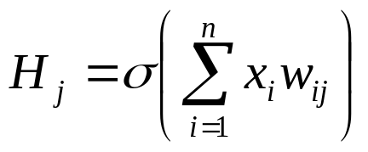
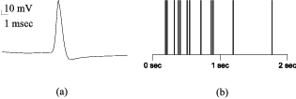
Модель нейрона
Обычный нейрон
Но в настоящих нейронах взаимодействие идет импульсами (спайками)
  Real neurons fire in spike trains
Wolfgang Maass, http://www.tu-graz.ac.at/igi/maass

Slide 4
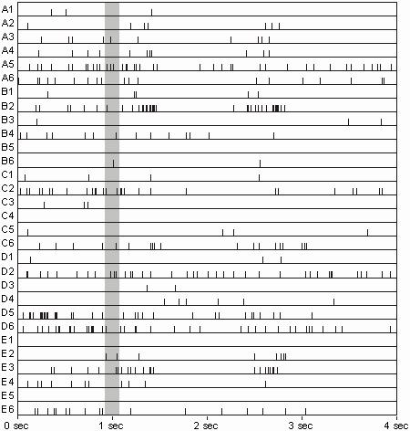
30 Neurons Firing in a monkey’s striate cortex
From Krüger and Aiple [Krüger and Aiple, 1988].
Reprinted from www.igi.tugraz.at/ maass/123/node2.html

Slide 5
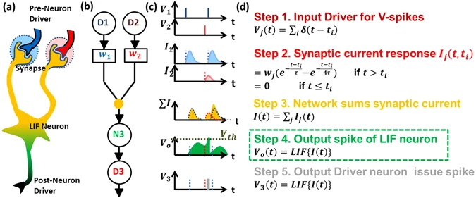
Leaky integrator
membrane potential
Input to neuron
Output over time
time

Slide 6
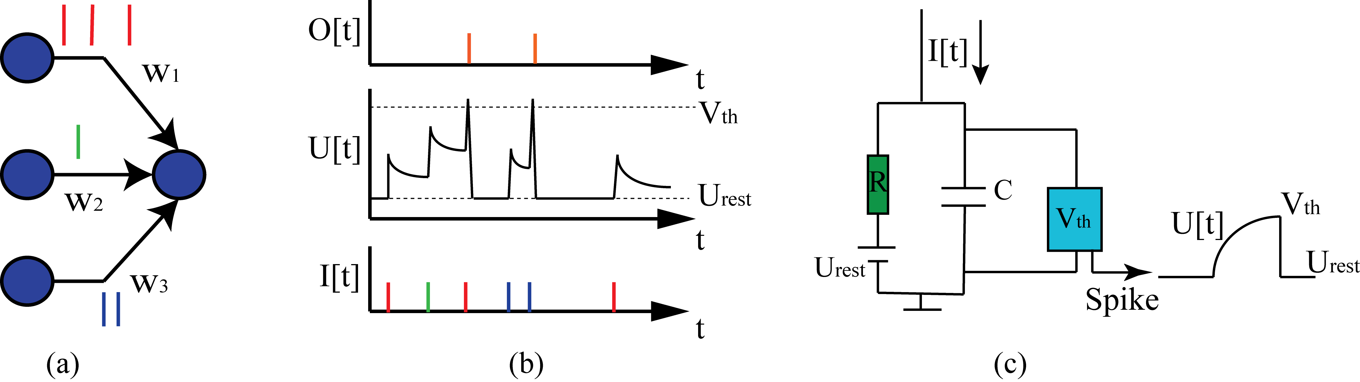
Leaky integrator

Slide 7
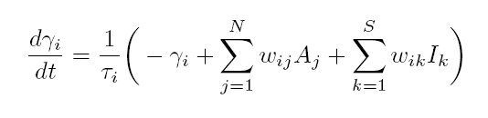
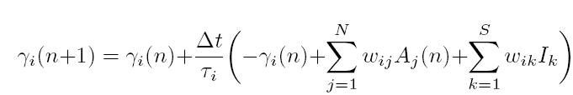
Leaky Integrator Equations
Leak
Дискретная версия
Equations from: Blynel, J., and Floreano, D. (2002). Levels of dynamics neural controllers. In Proceedings of the Seventh International Behavior on From Animals to Animats, 272–281.

Slide 8
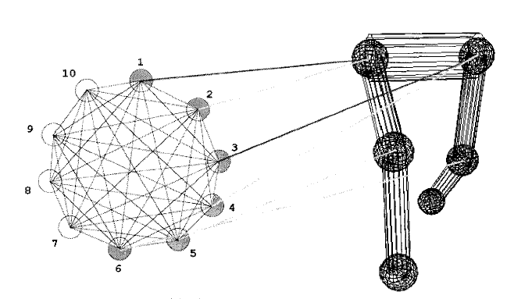
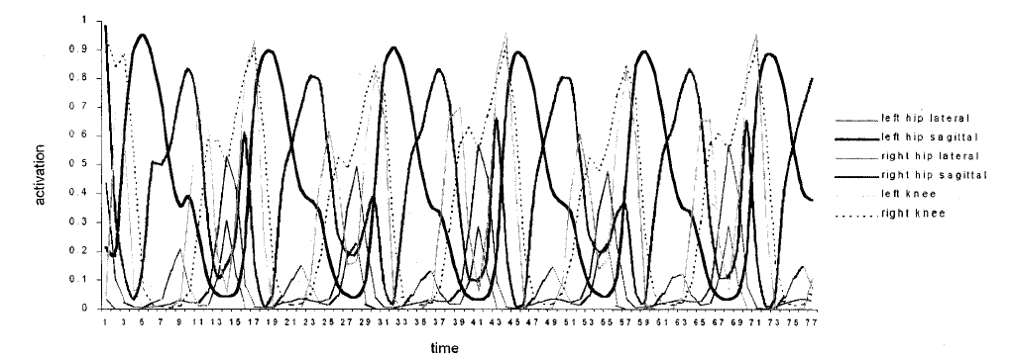
Walking gaits with no input!
Evolution of central pattern generators for bipedal walking in a real-time physics environment
T Reil, P Husbands - Evolutionary Computation, IEEE Transactions on, 2002

Slide 9
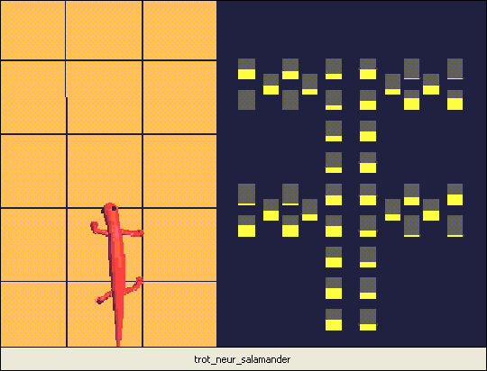
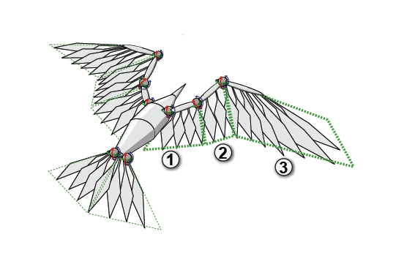
Salamander walking gait
Wing flapping
Ijspeert A.J.: A connectionist central pattern generator for the aquatic and terrestrial gaits of a simulated salamander, Biological Cybernetics, Vol. 84:5, 2001, pp 331-348.
Evolution of neuro-controllers for flapping-wing animats - group of 2 »
JB Mouret, S Doncieux, L Muratet, T Druot, JA … - Proceedings of the Journees MicroDrones, Toulouse, 2004

Slide 10
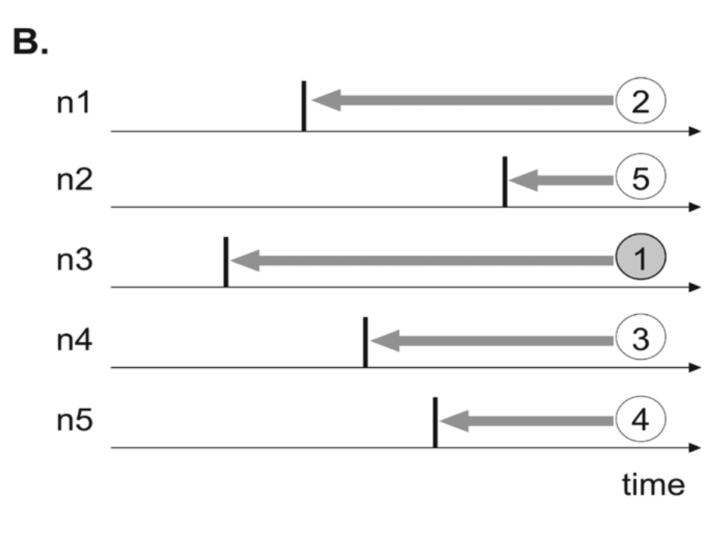
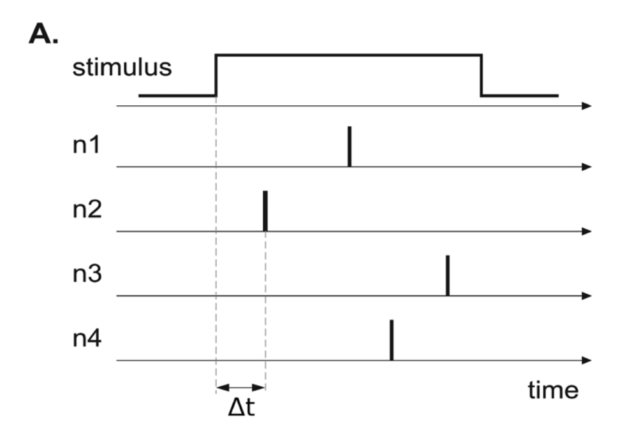
Кодирование спайков
Время до первого спайка
очень быстро,
просто,
достаточно емко
не устойчиво
Нужна синхронизация
Порядок нейронов до первого спайка
- Более устойчиво, точное время не важно

Slide 11
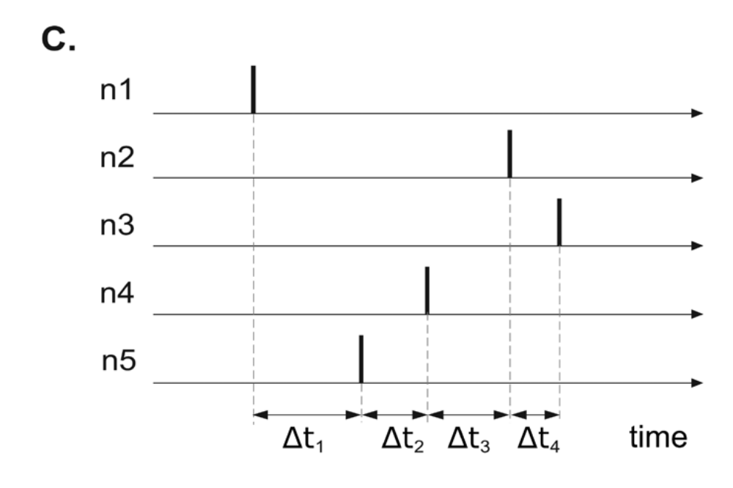
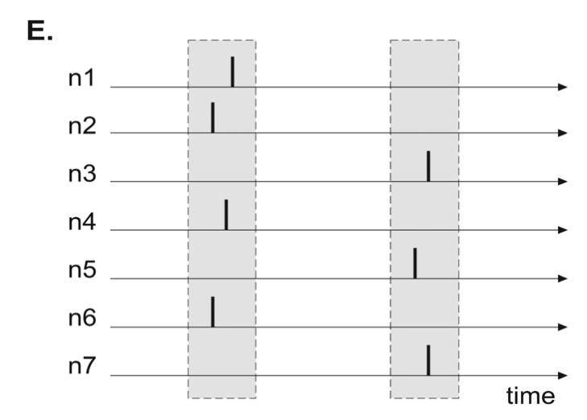
Кодирование спайков
Время между спайками
более емко
не устойчиво
Порядок нейронов в пределах синхроимульса
Более устойчиво
Достаточно емко
Лучше подходит для цифровых схем

Slide 12
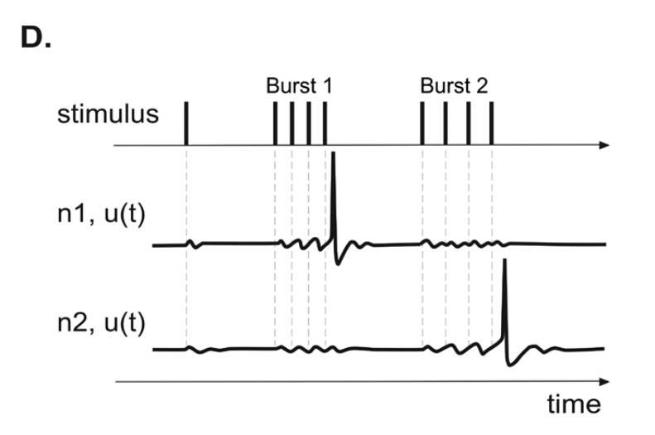
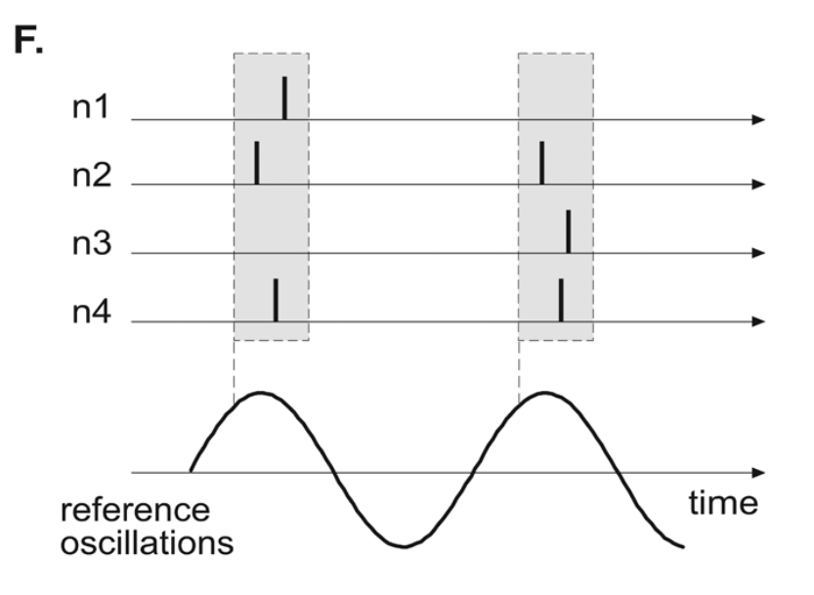
Кодирование спайков
Частота спайков, резонанс
Малая емкость
Фаза синхросигнала
Более управляемое,
Подходит для фазочастотных схем

Slide 13
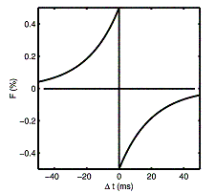
Spike Timing-Dependent Plasticity

Slide 14
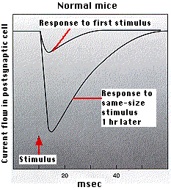

Slide 15
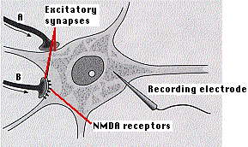
Synaptic Plasticity
Hebb’s Postulate: When an axon of cell A... excites cell B and repeatedly or persistently takes part in firing it, some growth process or metabolic change takes place in one or both cells so that A's efficiency as one of the cells firing B is increased.
In standard Hebbian learning, a synaptic weight is increased if presynaptic and postsynaptic neuron are `simultaneously' active. If neurons communicate by spikes, the concept of simultaneity implies the pre- and postsynaptic spikes occur within some time window. Theory predicts that these time windows could have two phases corresponding to an increase (potentitiation) or decrease (depresseion) of the synaptic weight depending on the relative timing of pre- and postsynaptic spike. Such asymmetric learning rules with two phases have been found in recent experiments.

Slide 16
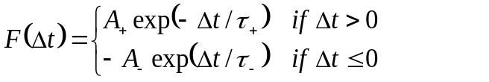
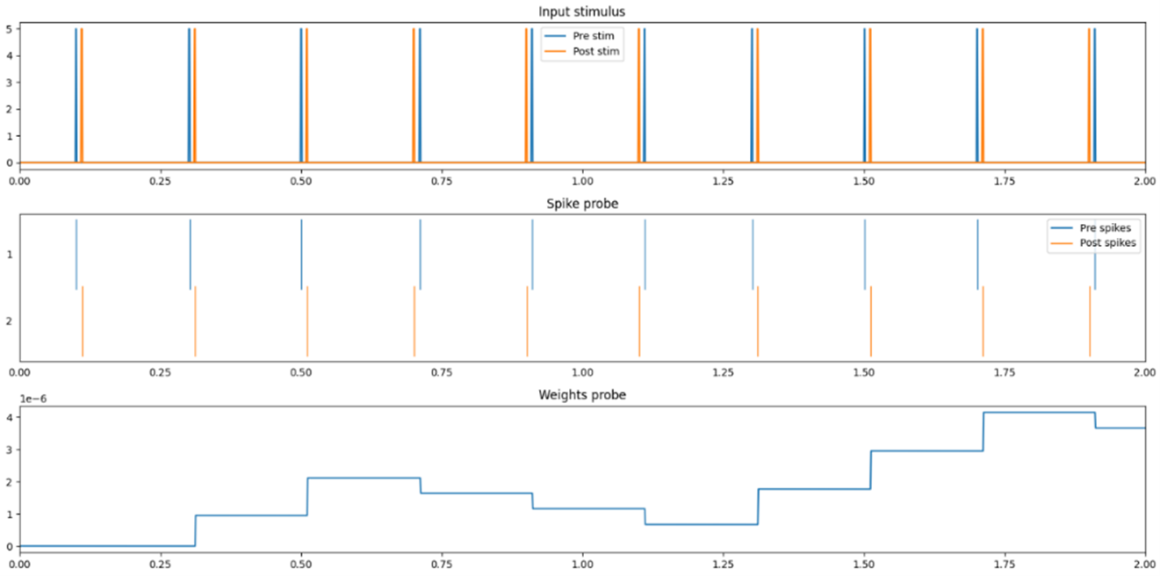
Strengthening
Weakening
t
t
t
t

